Slide 1
Single Point Lessons
Work Station for DELVE Full Face Shield manufacture
See also ‘Manufacturing SOP’ for source content
Approved: Ward Hills
Date: 01 April 2020

Slide 2

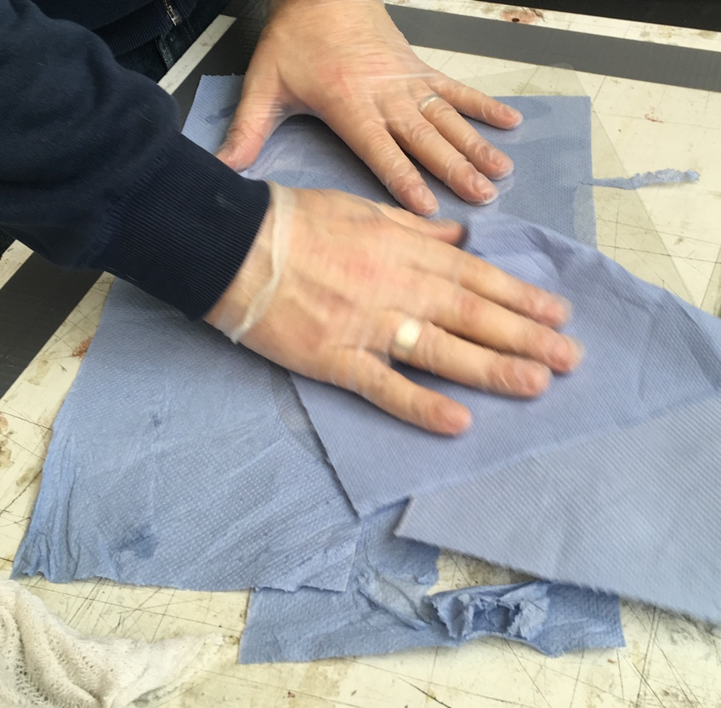
PET film Visor preparation for assembly
SAFETY: Handling IPA, eye protection
QUALITY: No scratches on the PET Film, all dust removed
Steps
Ensure the PET has its traveler with it
Check the lasered edge for sharpness or burning with a gloved finger - glove should not snag
Place visor onto a clean, soft, non shedding surface
Wipe gently with a tissue moistened with cleaning solution or IPA, removing all laser cutting dust. Make a maximum of FOUR light strokes
Reverse and repeat 3. and 4. for side 2
Place carefully into the WIP box
Book the operation into the batch record system (Chromebook).
Write an A5 traveler with the job number and your initials. Place into WIP box. Remove the incumbent traveler.
Approved: Ward Hills
Date: 01 April 2020

Slide 3
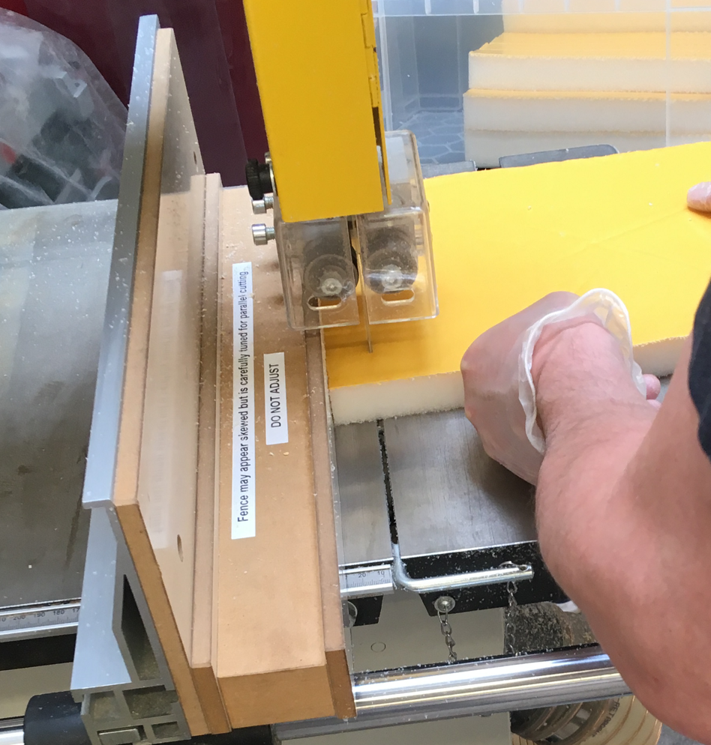
Foam Prep
QUALITY: Adhesive backing should be full width of cut block.
Part to be cut to size and square
SAFETY: Bandsaw, Induction trained.
Steps
Ensure the Foam has its traveler with it
Set guide fence to 23.5cm. Cut on the bandsaw. Set to 2.8cm. Cut. Ensure block is against guide fence at all times
Remove any excess dust
CHECK: adhesive layer runs full width and length of the block
Place into a WIP box
Book the operation into the batch record system (Chromebook)
Write an A5 traveler with the job number and your initials. Place into WIP box. Remove the incumbent traveler
Approved: Ward Hills
Date: 01 April 2020

Slide 4
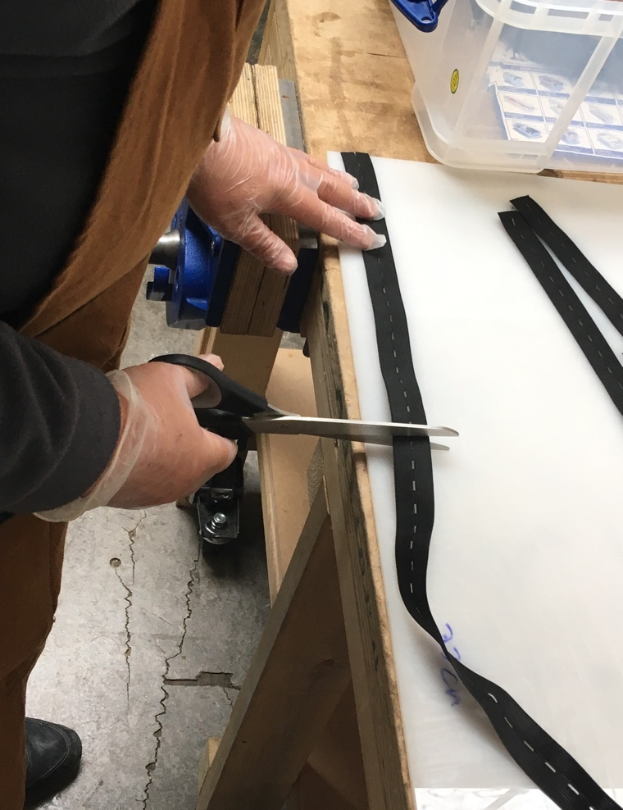
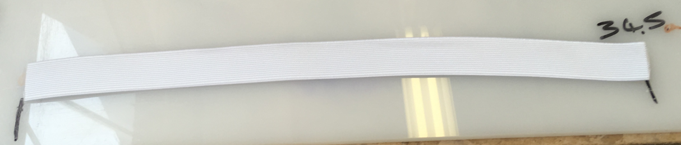
Elastic Prep
QUALITY: Correct Length
Cut needs to be Square across web
Steps
Ensure the Elastic has its traveler with it
Measure to length
Cut with sharp scissors
Remove any fraying edges (Fine full width fibres)
Place into WIP box
Book the operation into the batch record system (Chromebook)
Write an A5 traveler with the job number and your initials. Place into WIP box. Remove the incumbent traveler
SAFETY: None
Approved: Ward Hills
Date: 01 April 2020

Slide 5
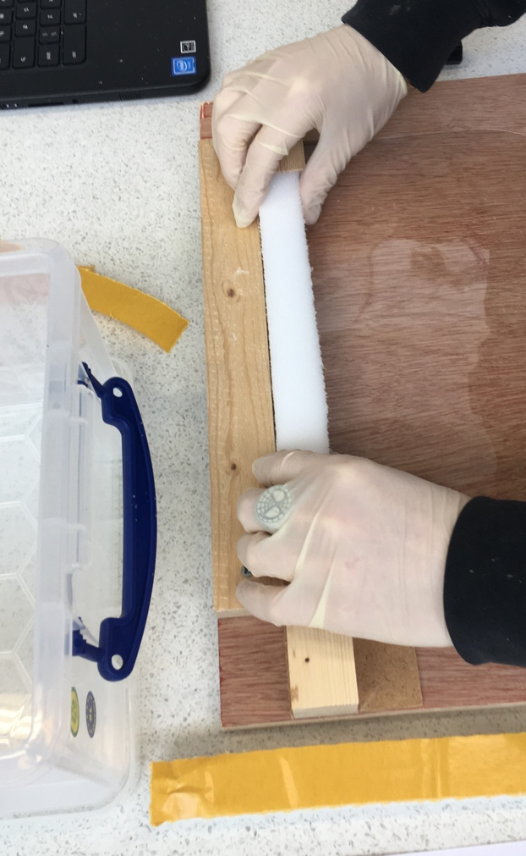
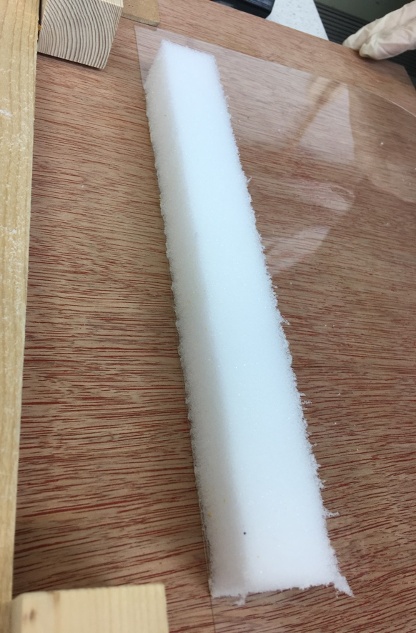
Foam-PET Assembly
QUALITY: Foam fits in correct position. Foam fully attached. Foam adhesive not above PET visor edge
Steps
Ensure the Foam and PET have travelers. Where two batches are present, use the lowest job number first
Ensure the jig is clear of debris
Place the PET into the jig
Remove the release paper from the foam with a knife point
Place the foam onto the PET
Place into a WIP box
Book the operation into the batch record system (Chromebook)
Write an A5 traveler with the job number and your initials. Place into WIP box. Remove the incumbent traveler
SAFETY: Sharp blade required
Approved: Ward Hills
Date: 01 April 2020

Slide 6
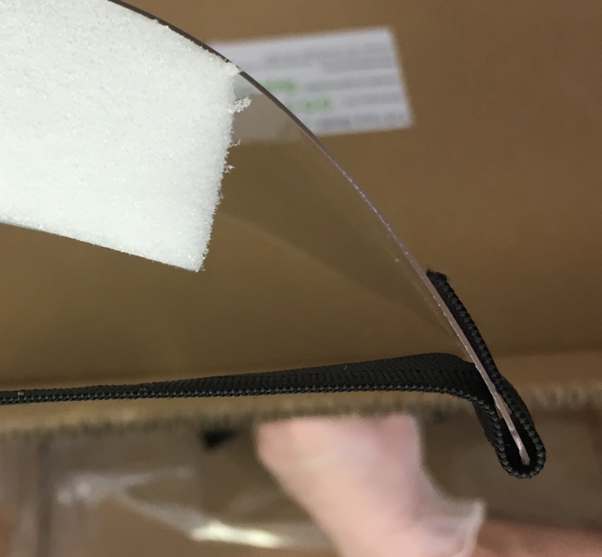
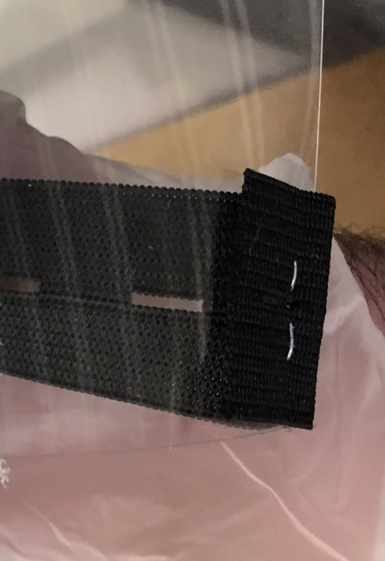
Elastic Stapling
QUALITY: Correct elastic routing.
Staple fully formed, no sharp points
Steps
Ensure the cut Elastic and visor have travelers. Where two batches are present, use the lowest number first
Route elastic as shown, with end on OUTSIDE of visor
Staple through once from the INSIDE of the mask
Repeat 2. and 3. at the other side
Place into a WIP box
Book the operation into the batch record system (Chromebook)
Write an A5 traveler with the job number and your initials. Place into WIP box. Remove the incumbent traveler
SAFETY: Stapler action
1 cm
INSIDE
1 cm
OUTSIDE
OUTSIDE
Approved: Ward Hills
Date: 01 April 2020

Slide 7
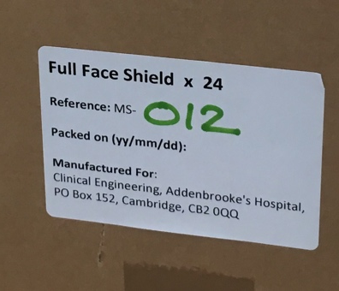
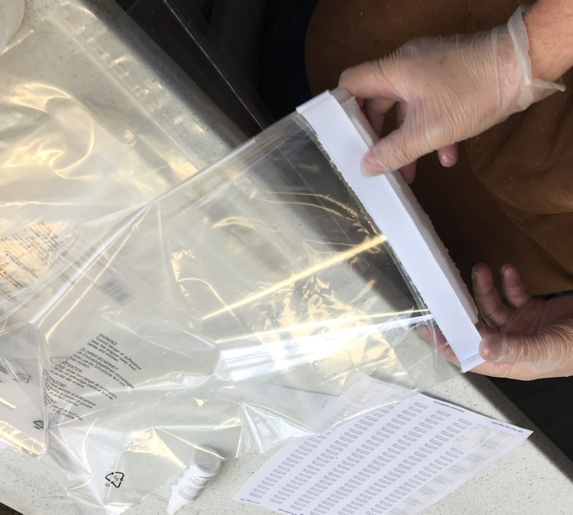
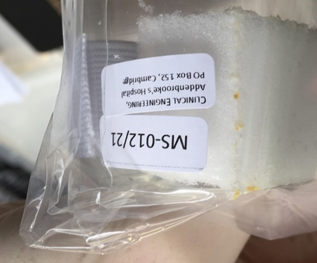
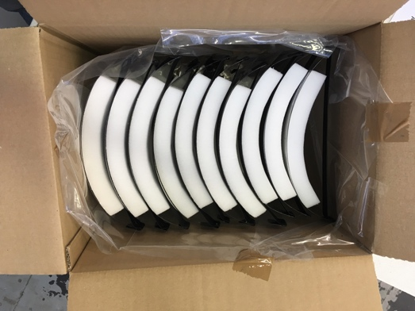
QA and Packing
QUALITY: Visor Scratches;
Visor edge NOT sharp;
Elastic length;
Fully stapled and NOT sharp Foam; Foam Adhesive full width;
No foam overhang top of visor
SAFETY: None
Steps
Ensure completed shields have a traveler
Make up a carton. Apply its label (MS-xxx)
Place the shield onto the packet of bags, spray with demister and wipe with a cloth
Reverse and repeat 3. on other side
Perform checks, as per the checklist at the station
Record QA FAIL jobs one-at-a-time on the batch record system. Place into reject bin
Apply both labels to the PASSED shield. Use the MS-xxx/zz labels to match the Carton label
Bag the shield
Place into the carton. Repeat for the batch
Add Shields from the “TOP UP” box to make 24-off Carton Quantity
Book the PASS operation into the batch record system (Chromebook). Note on job card if units taken from “TOP UP” box
Remove the incumbent traveler. Write an A5 traveler with the job number and your initials. Masking tape onto the Carton
Approved: Ward Hills
Date: 01 April 2020

Slide 8
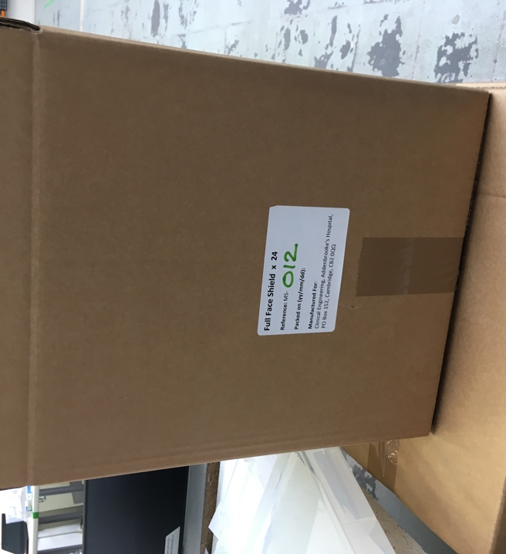


Carton (Boxing)
QUALITY: MS-xxx Carton and Shield labels match
Shields are packed correctly in carton
Steps
Ensure carton has a QA traveler taped to it
Check the Carton and Shield MS-xxx numbers match
Place Instructions For Use sheet inside Carton
Close up the Carton
Book the operation into the batch record system (Chromebook)
SAFETY: None
Approved: Ward Hills
Date: 01 April 2020

